Slide 1
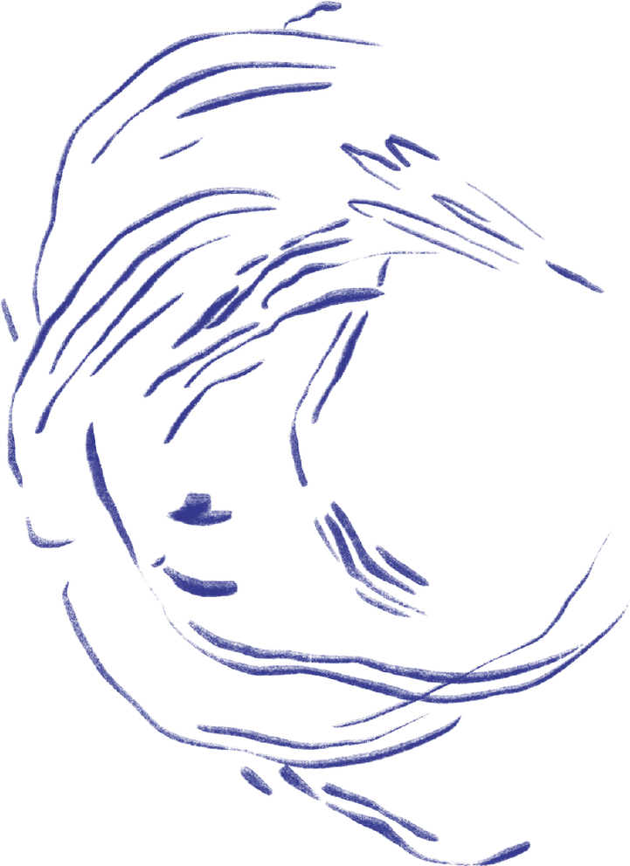
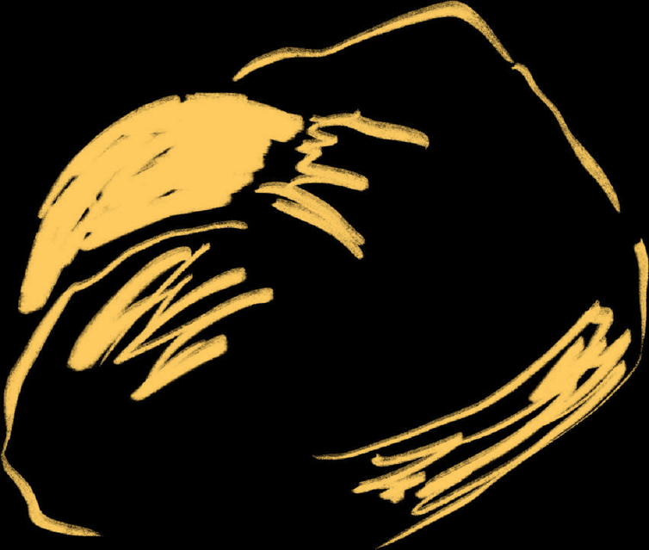

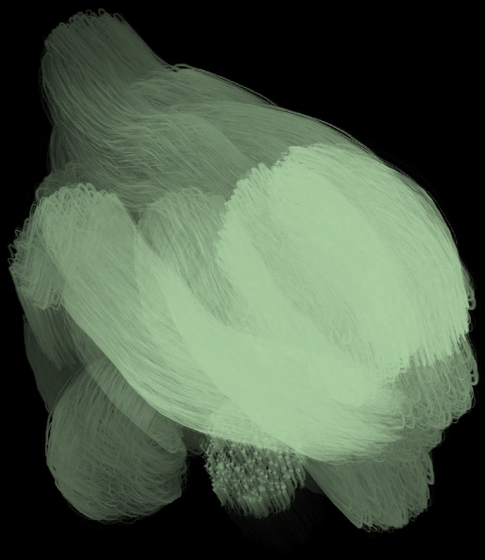

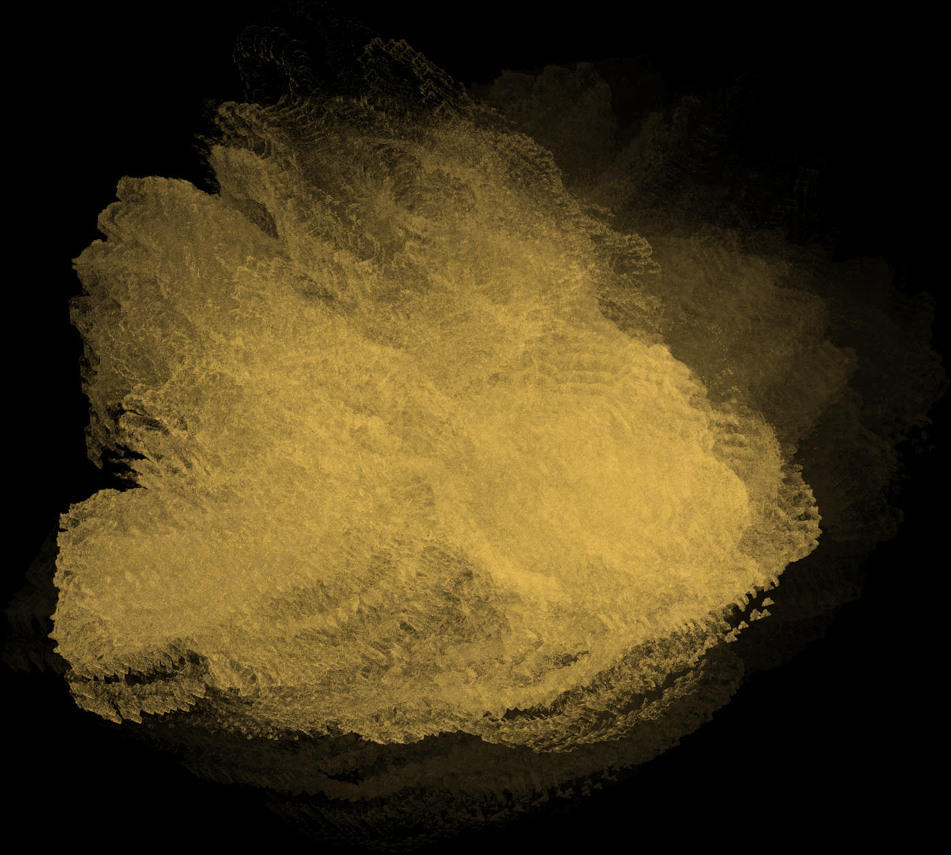

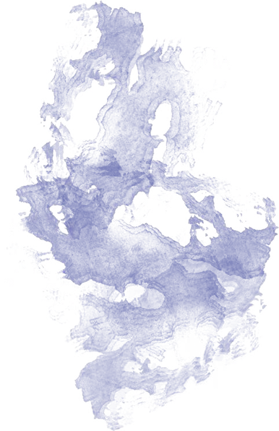
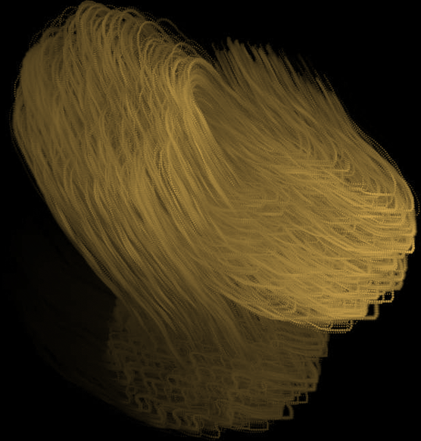
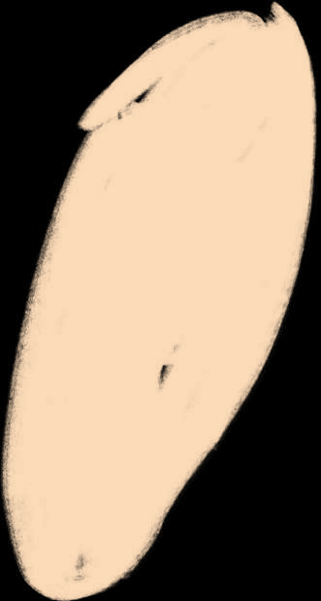
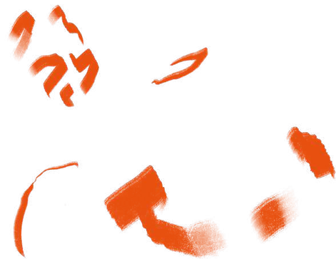

Wine at the Heart

Slide 2
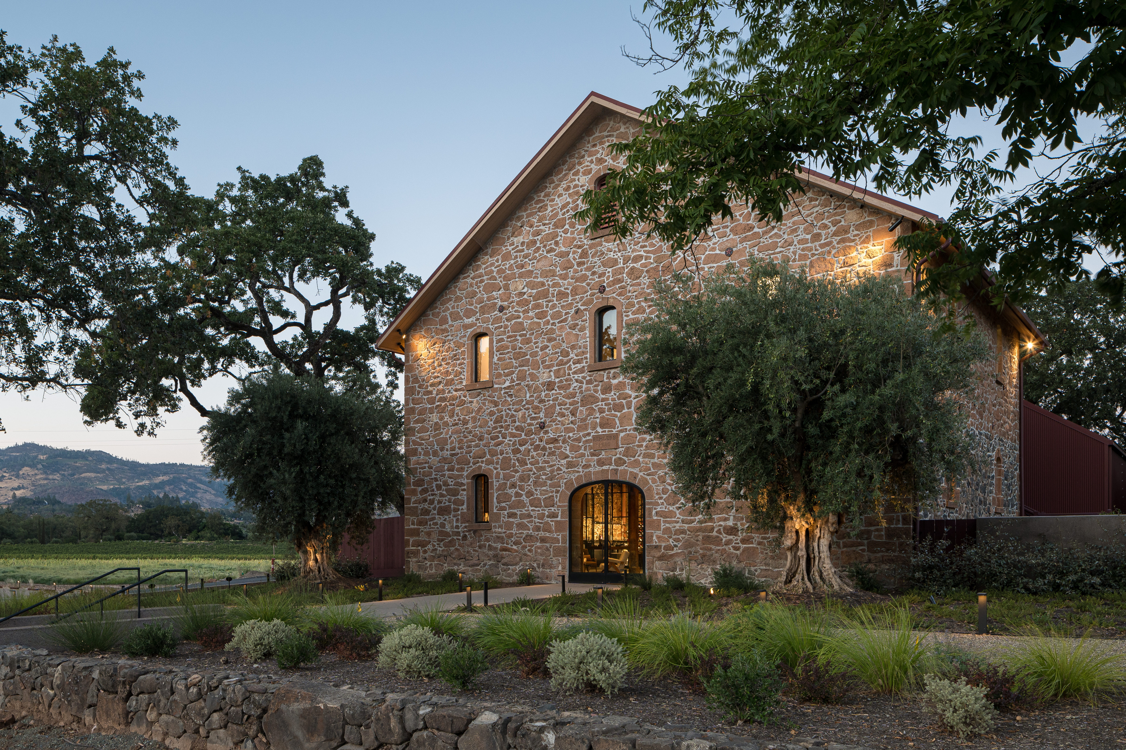
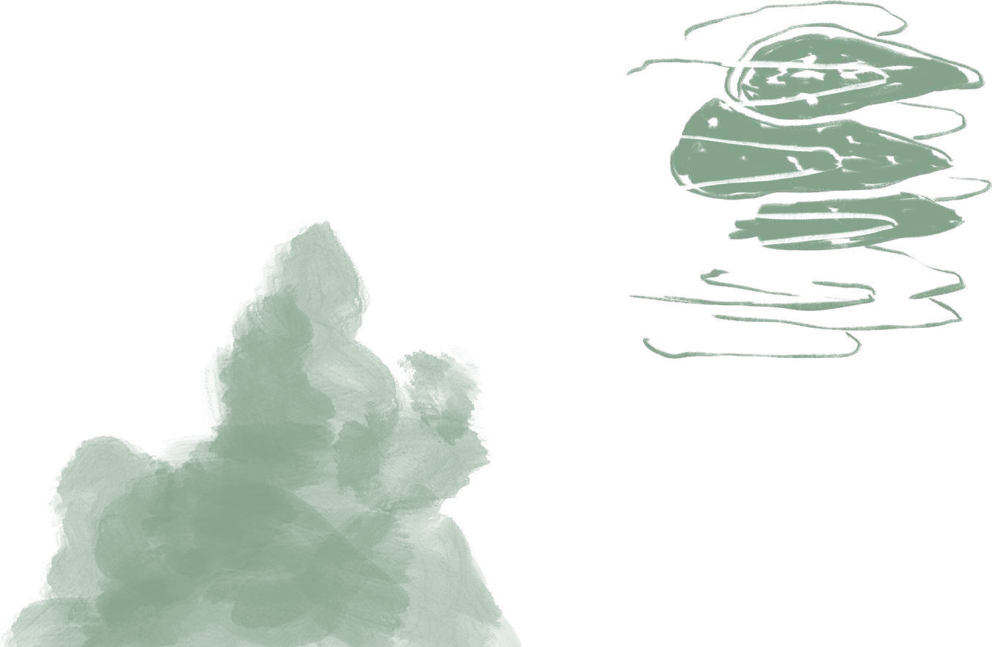
MISSION / VISION
Ehlers Estate transcends the traditional winery experience. We stand as a testament to Napa Valley’s rich heritage while shaping a future where wine serves as a catalyst for connection,
well-being, and thoughtful innovation. With deep respect for the land and a steadfast devotion to the art of winemaking, we craft exceptional estate-grown wines that reflect both our French roots and a forward-looking vision.

Slide 3
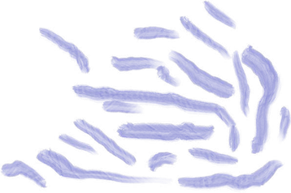
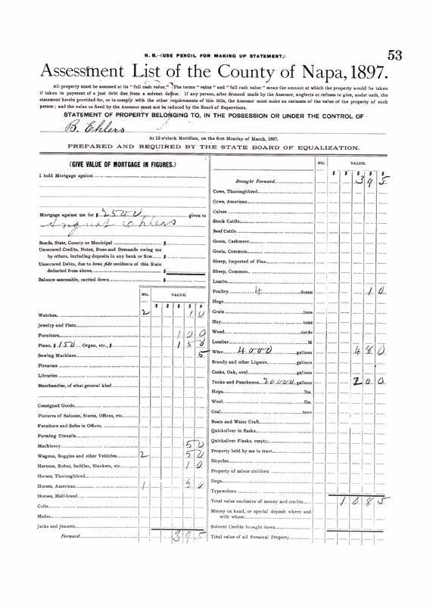
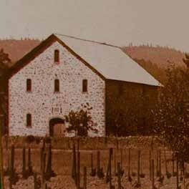
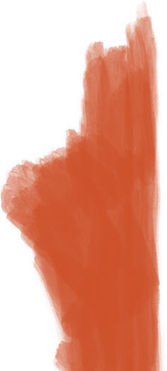
In 1885, Bernard Ehlers and Anna Stolls established a small winery on this land, planting the foundation of what would become Ehlers Estate. Over the next hundred years, the property passed through many hands — each leaving their mark, each adding to the story.
In 1987, Jean and Sylviane Leducq came to the estate with a long-term view. Inspired by a belief in thoughtful stewardship and the potential of this land, they began the work of restoration — reviving the vineyards, restoring the stone winery, and placing the estate in a trust to ensure its purpose would extend beyond profit.
Their legacy continues to shape the way we farm, the way we make wine, and the way we engage with the world around us.
Historical Reverence

Slide 4

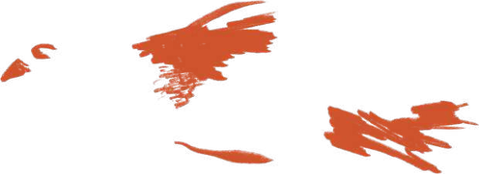
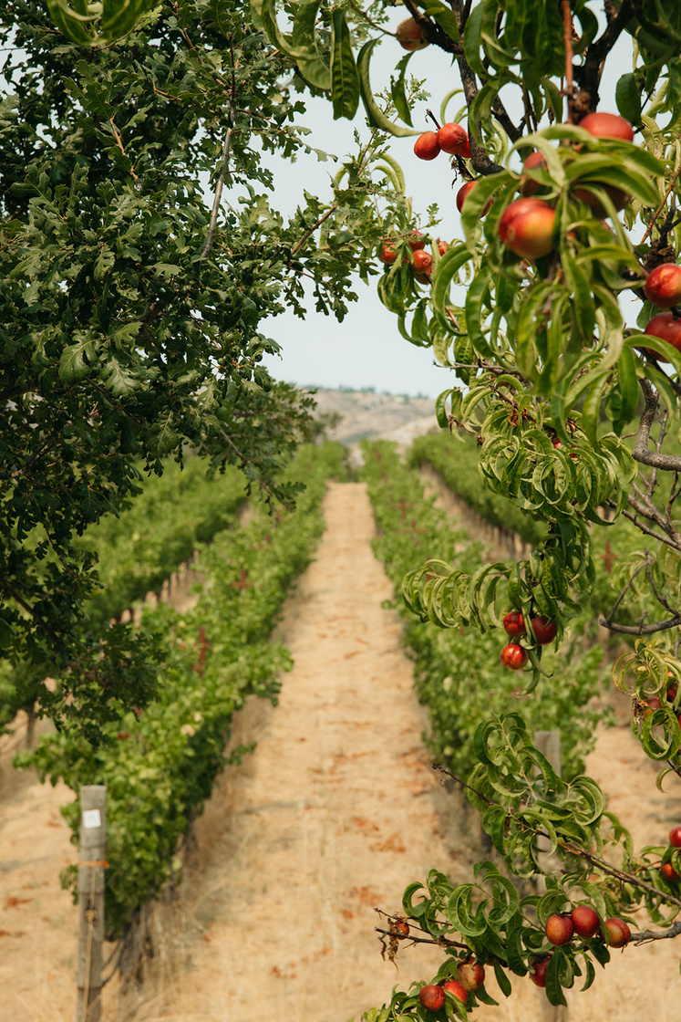
While it may sound modern, winegrowing honors the traditional view of wine that recognizes viticulture and vinification as part of a seamless, integrated process rather than separate operations. In grounding our focus on the health of our land to produce the quality and character that is unique to this site, we align our efforts to compose exceptional wines that exemplify this place, our foundation in its history, and our commitment to its future. Our vineyards have an average of 35% gravel, with some blocks containing as much as 65%.
Estate Vineyard has been organically farmed and certified by the CCOF since 2008.

Slide 5

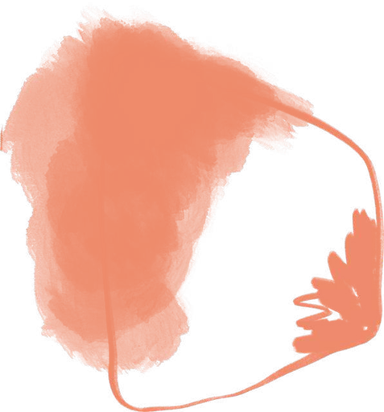
Our approach emphasizes the authenticity of the grapes and the environment we call our estate.
The spirit of adventure and curiosity permeates every facet of our winemaking process.
There's an exhilarating sense of intentionality, a fervent desire to capture those fleeting moments that define a vintage.
Ultimately, our goal is to craft wines that transcend being a mere product; they are stories waiting to be told.

Slide 6
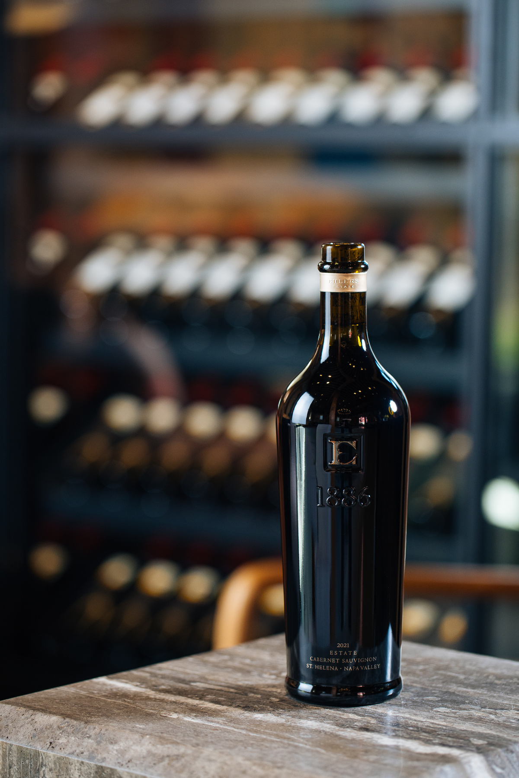
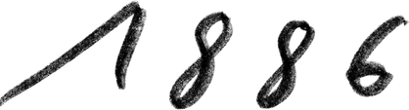
Appellation St. Helena
Vintage 2022
100% Cabernet Sauvignon
Of the many great vintages here in Napa, 2022 is high amongst them. A dry winter and warm spring limited vine growth, resulting in small, intensely concentrated berries. A mild autumn allowed for ideal ripening conditions, delivering perfectly matured fruits to the great relief of winemakers everywhere. The wines will slowly unfurl over what will be an exceptionally long window, each stage revealing new dimensions and features.
TASTING NOTES
The 2022 1886 is dark and brooding, with a diverse range of aromas ranging from crushed blackberries and red cassis to hibiscus blossom and smoked paprika. In the mouth it is svelte, delivering a long, structured experience detailed by flavors of steeped flowers, berry compote and hoisin sauce. This is a wine of sublime finesse, and will age for several decades to come.
3.69 pH | 15.2% alcohol
20 Months Barrel Aging

Slide 7
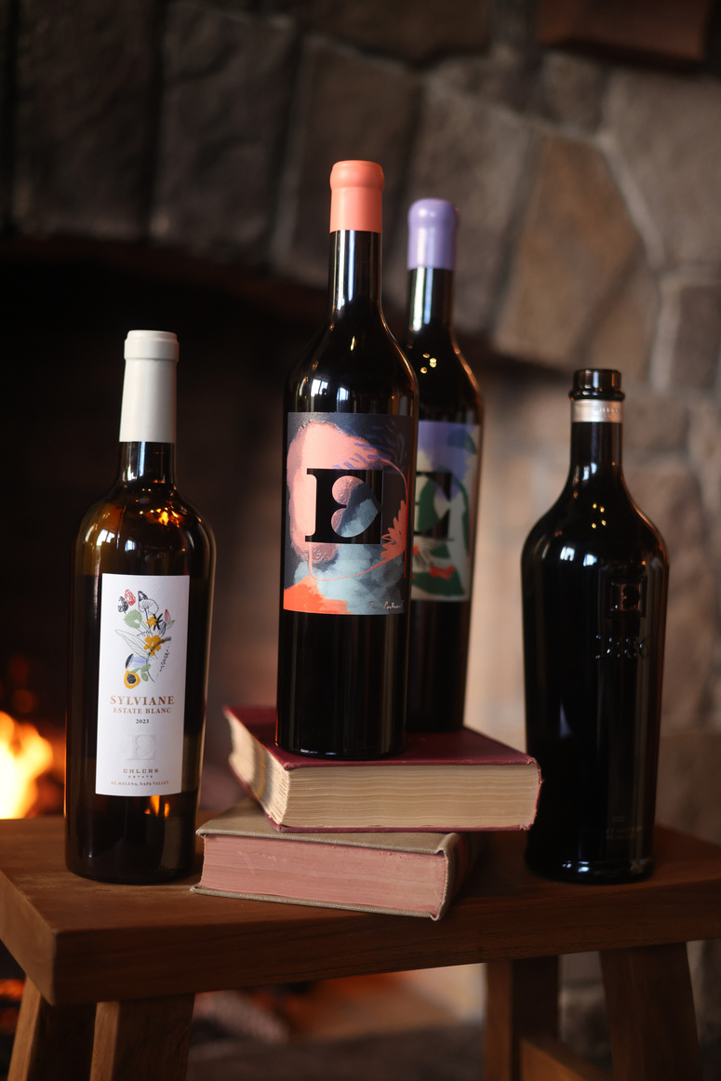
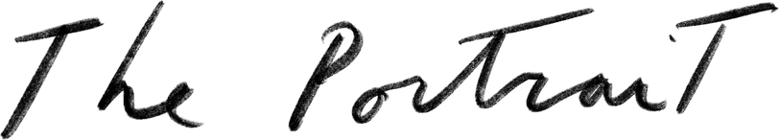
TASTING NOTES
A hugely sexy and multi-dimensional, albeit remarkably dark nose of creme de cassis, bitter chocolate and black cherry preserves with new leather, cigar box and pulverized rock twisting and turning around each other, at times showing some pressed flowers, grilled herbs, at others camphor, sweet olive tapenade, and pencil lead. It is rich and inviting but suggests a more savory disposition over a sweet one.
Typical of the vintage, the tannins are firm, with a rocky sort of minerality that intersects the clean, almost refreshing acid without a detectable delineation. The texture is plush, but not thick, and has the effect of enhancing the perception of fruit ripeness and intensity without feeling sugary - quite an impressive trick. It is long and planar, driving in finely stacked layers for what feels like almost minutes, flavors rotating and blending between dark fruit crumble, baking spices and earth. It is a rare case of having early accessibility and long-term excellence, and one that I hope to see again!
The 2023 growing season in Northern California was so ideal it will be almost entirely forgotten. Yet, we will rediscover this vintage for decades to come, struggling to remember the perfect conditions that produced such depth, structure, and finesse. This vintage is a confrontation to the collective lethargy of transient fashion, a bridge to the past and [hopefully] future, and a (re)affirmation of our ability to produce classic wines of mythical proportions, reorienting our self-conception as stewards of a cultural legacy truly worth the pursuit.
Harvest: September 29th - October 26th, 2023
Fermentation: Average 19 days on skins in stainless steel tank
Blend: 87% Cabernet Sauvignon, 7.5% Cabernet Franc, 3.5% Petit Verdot, 1.25% Malbec and 0.75% Merlot
Elévage: Aged 21 months in 47% new French oak
Bottling: August 20th, 2025

Slide 8
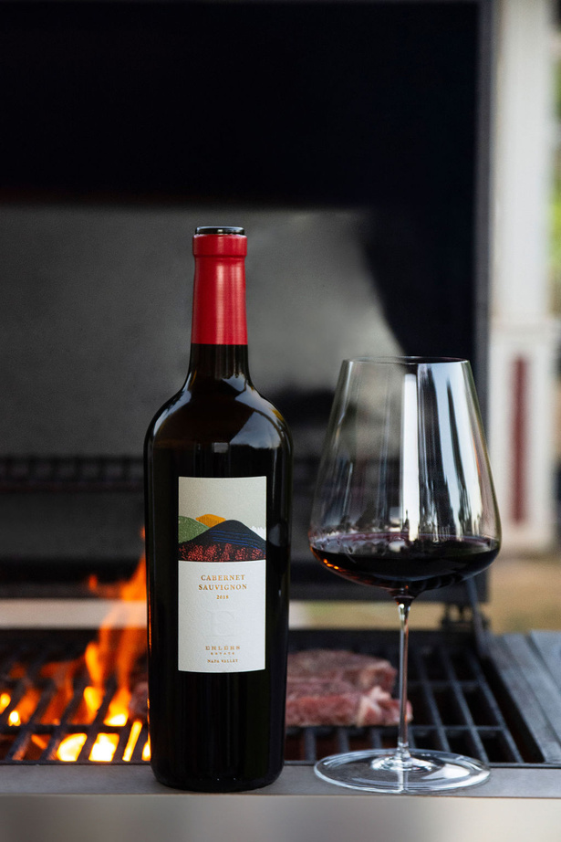
87.6% Cabernet Sauvignon
11.3% Cabernet Franc
1.1% Petit Verdot
TASTING NOTES
The 2023 growing season in Northern California was so ideal it will be almost entirely forgotten. Yet, we will rediscover this vintage for decades to come, struggling to remember the perfect conditions that produced such depth, structure, and finesse. This vintage is a confrontation to the collective lethargy of transient fashion, a bridge to the past and [hopefully] future, and a (re)affirmation of our ability to produce classic wines of mythical proportions, reorienting our self-conception as stewards of a cultural legacy truly worth the pursuit.
Truly classic, and often rare to find varietal aromas of blueberries, sweet herbs, pipe tobacco and dried flowers lead to camphor, blackberry galette and iodine. Wonderful, organized acidity presents a direct line from the immediate entry all the way through the finish without even the smallest wavering. Fine, chalky tannins follow rather than lead, though the cool, firm character of the vintage is still apparent. Violet candies, graphite, savory herbs and the darkest pomegranate you’ve ever tasted are oddly persistent but not obnoxious. This is exactly the type of construction that made Napa so beloved and that we are remembering.
2023 Napa Valley Cabernet Sauvignon
21 months Barrel Aging
65% new French Oak

